Slide 1



Conjugate Prior Bayesian Models Smart defaults and updating estimates over time
Anitha Sivasubramanian
Principal Data Scientist
John Wiley & Sons.,

Slide 2


DELIVERS
Mastery-based adaptive learning platform
Learning
that lasts
Remediation across alta’s complete library of content
Retain, recall and apply in the future
Notes:
Brief intro about ALTA and what we do

Slide 3
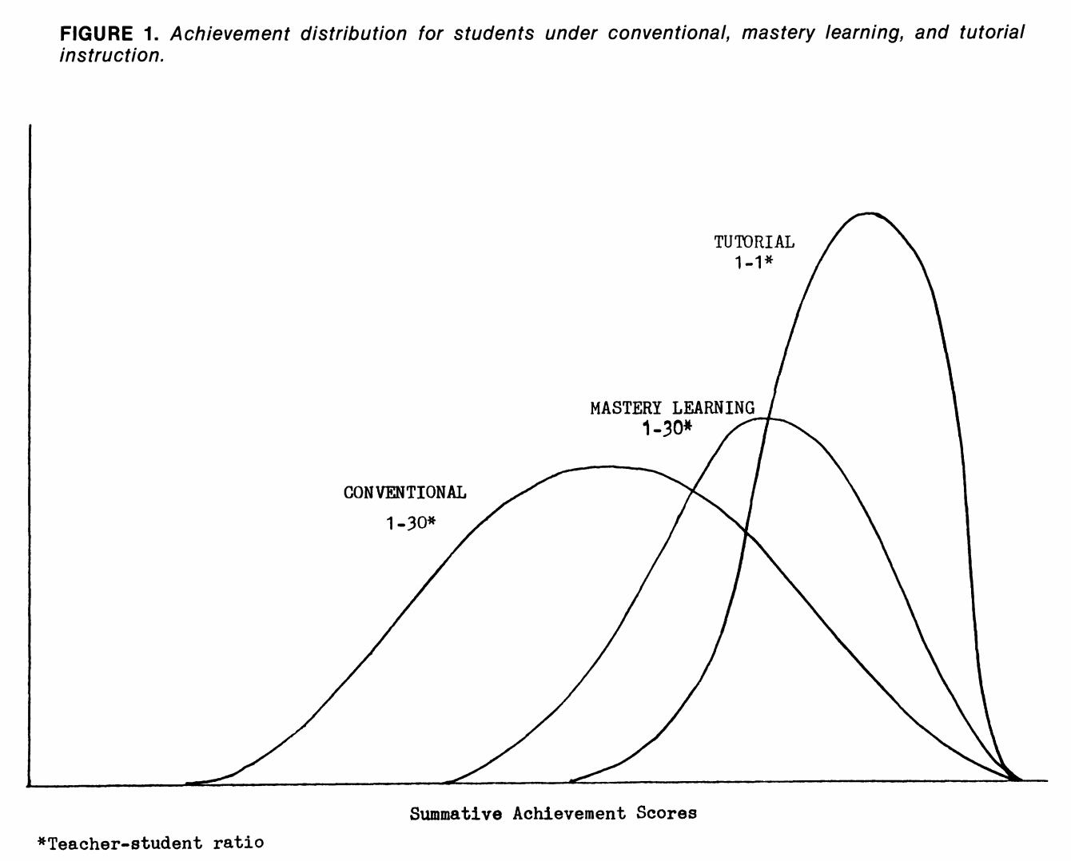
Mastery-based Learning
Pedagogy recognizing that different learners may need different paths to reach the same ability level
Immediate feedback and correctives
Many opportunities to demonstrate mastery
Meaningful exit criteria
Learning science says: great outcomes!
Bloom 1984
Reference : http://web.mit.edu/5.95/readings/bloom-two-sigma.pdf

Slide 4
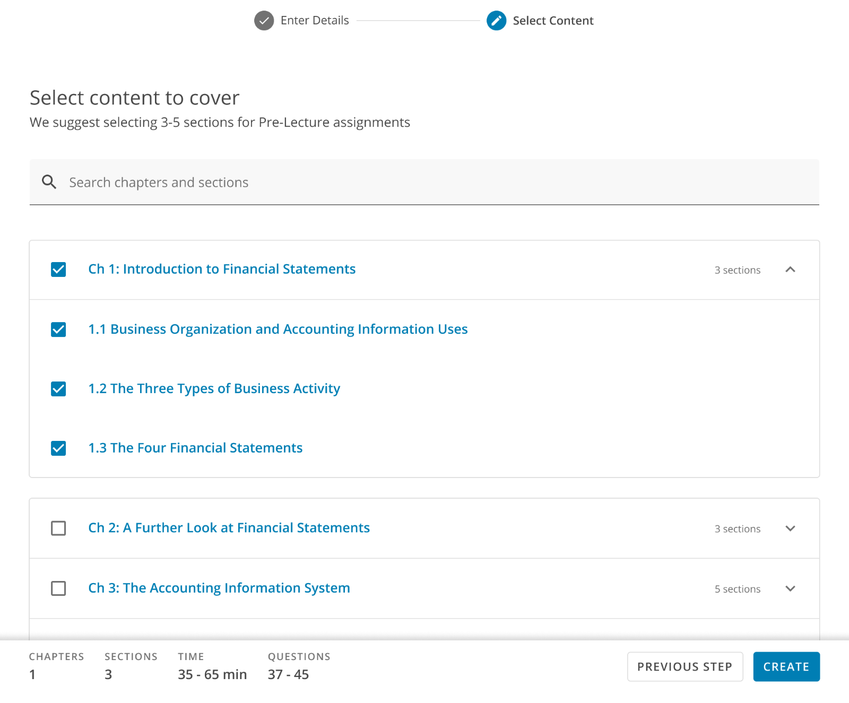
Implication of mastery learning
Different students will require different amounts of time for their homework
When instructors are assigning homework, it is important for them to have a view of how much work they are assigning
Notes:
for personalization

Slide 5
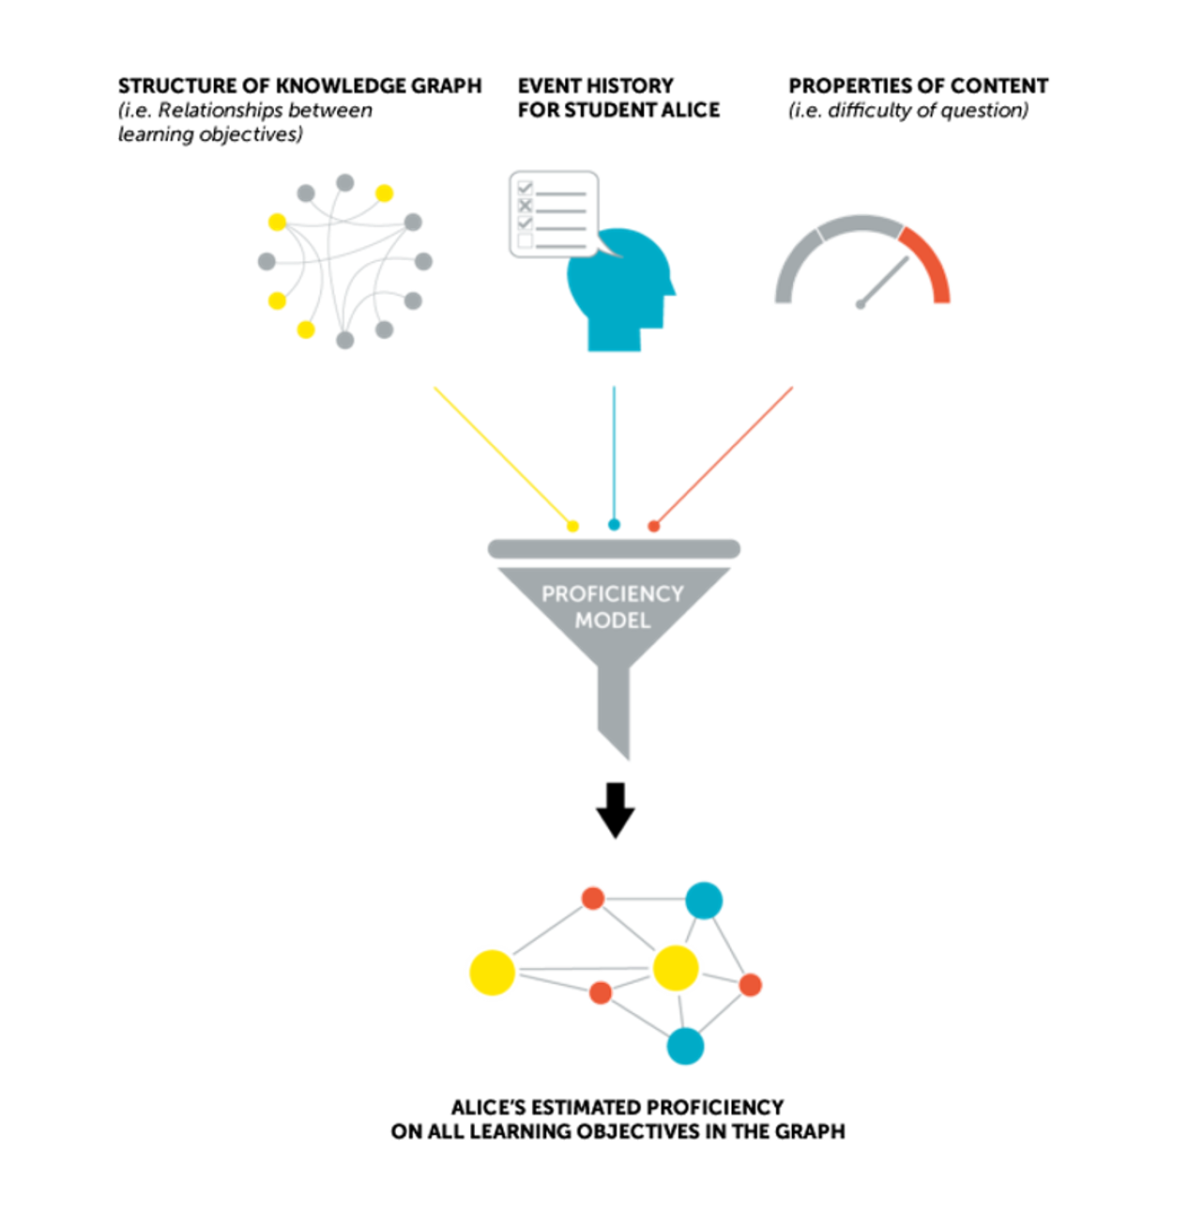
Knowledge States at the center
Things the ALTA platform knows:
Relationships between learning objectives and content​
How all other/previous students performed​
The current student’s learning history
With that data, we recently revamped how we compute the assignment time and question estimates surfaced in ALTA using prior data.
Number of questions
Adaptivity
Analytics
Duration

Slide 6
Why Bayesian model?
Challenge
Prior data is sparse and evolving
What we need?
A model that will start with smart defaults
Why Bayesian?
Quickly scale from no data to little data to lots of data smoothly
Each Learning objective (LO) is different and
New LO/domains will not have any historical data
And continue to update over time the estimates for number of questions and duration
Explicitly predict uncertainties
Guarantee transparency in the user/model behaviors
Adaptivity
Analytics

Slide 7
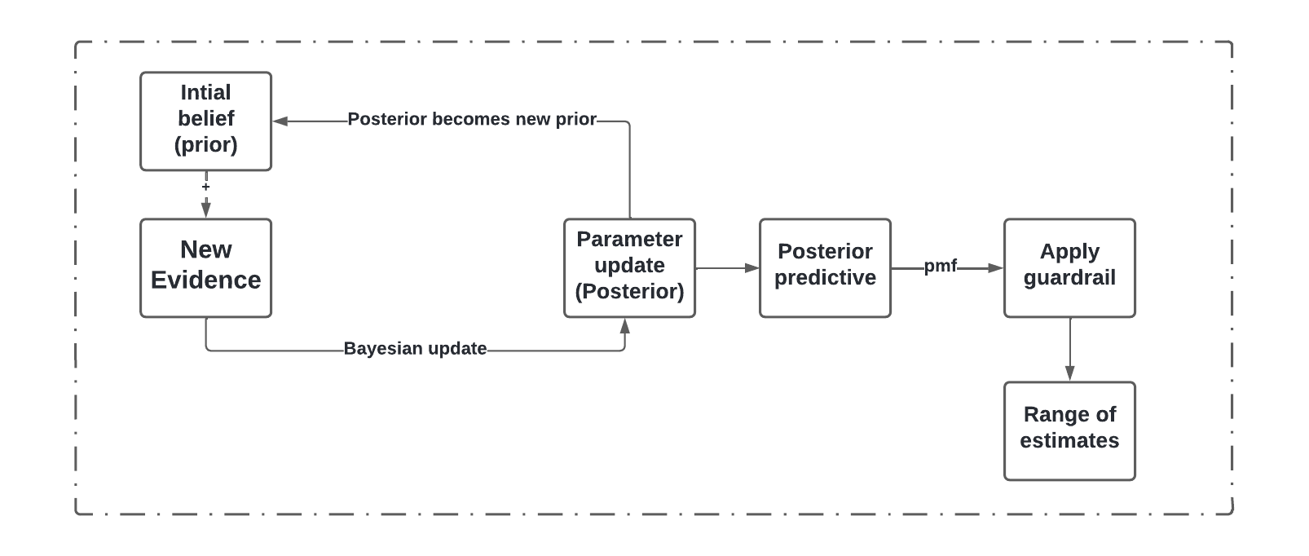
Bayesian updating
Adaptivity
Analytics

Slide 8
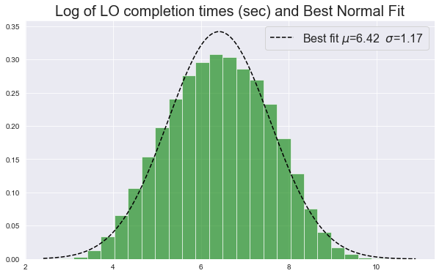
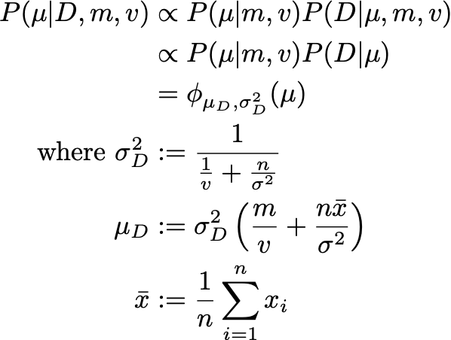
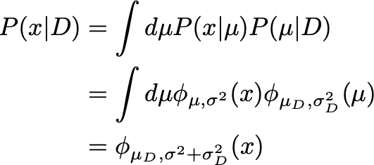


Modeling (Duration)
(m, v) := the Normal prior mean and variance of the mean μ of the presumed Normal data-generating model (i.e. the likelihood) of log-completion times
σ2 := the “known” variance of the data generating model of log-completion times
Prior
Adaptivity
Analytics
Likelihood
Posterior Predictive
Posterior = Prior * Likelihood

Slide 9
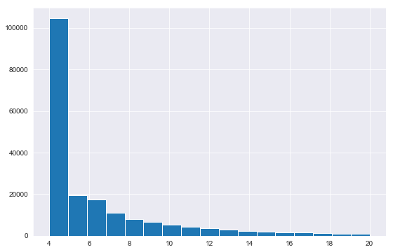
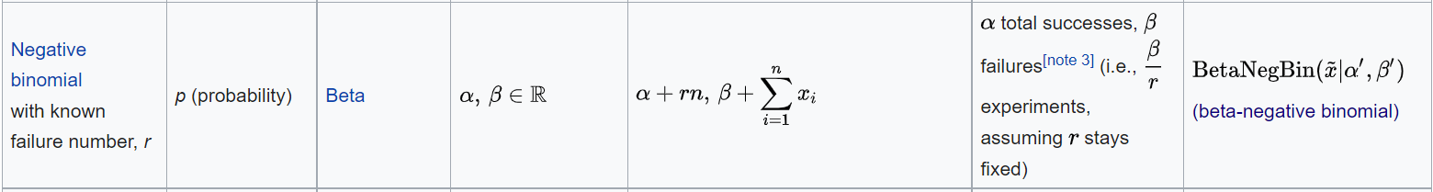
Modeling (Number of questions)
Number of successes is fixed as 2
Probability of success is unknown => model parameter
Likelihood * prior = Posterior
Adaptivity
Analytics

Slide 10
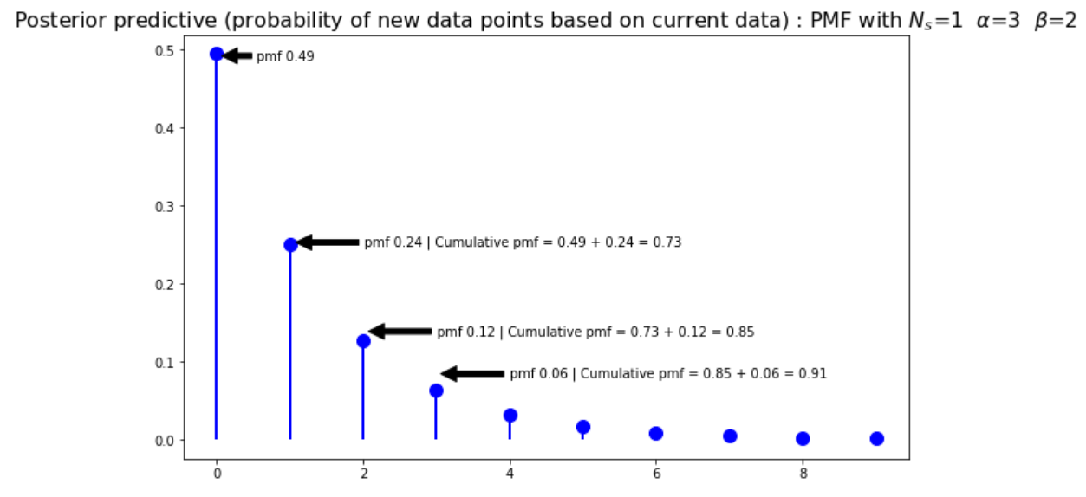
Posterior predictive
Based on the posterior hyper parameter alpha and beta, compute the posterior predictive
And then we take the 90th percentile to estimate the high estimate
So, the model predicts that 90% of students will finish at the high estimate or less questions
Adaptivity
Analytics
This helps in explicitly predicting uncertainties

Slide 11
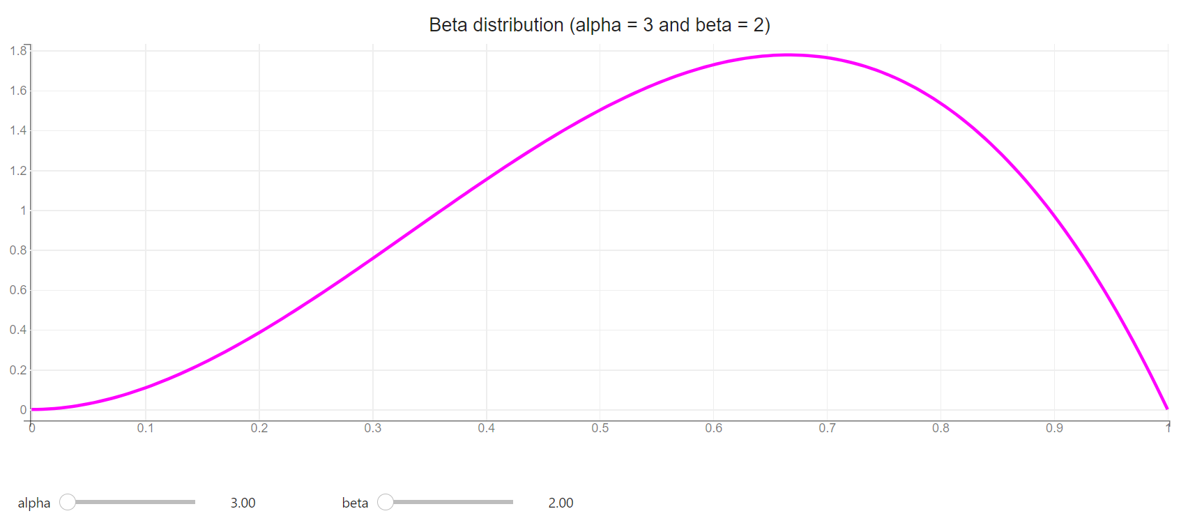
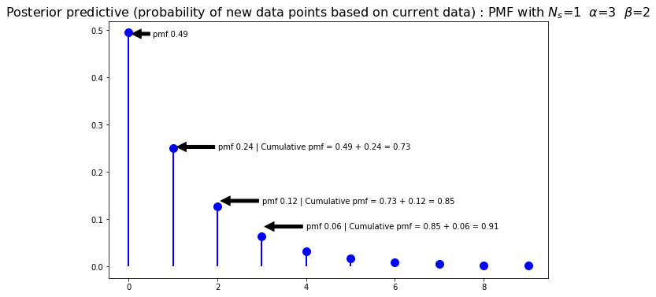
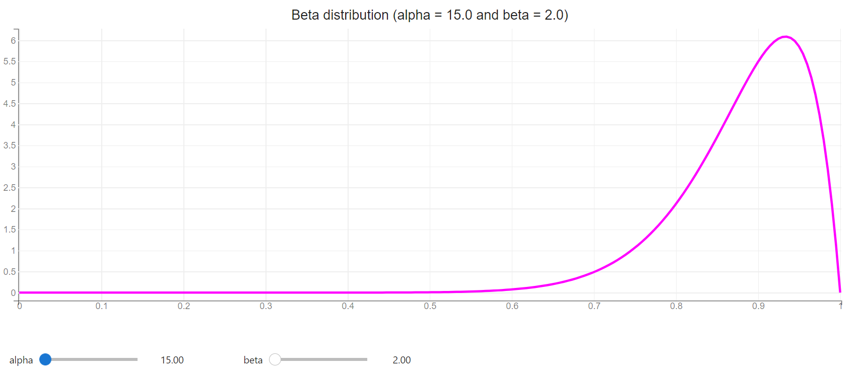

Prior to posterior transformation
Adaptivity
Analytics
The graphs show the transformation of prior to posterior as new evidence arrive

Slide 12
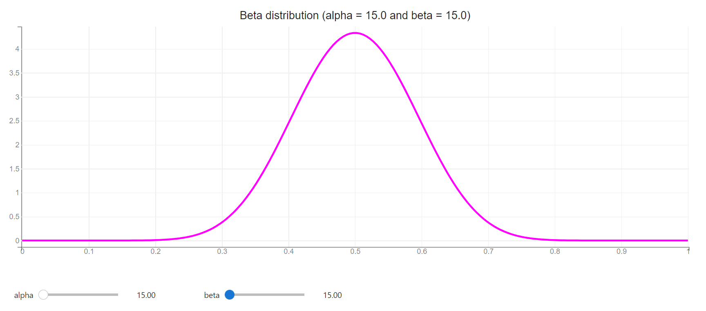
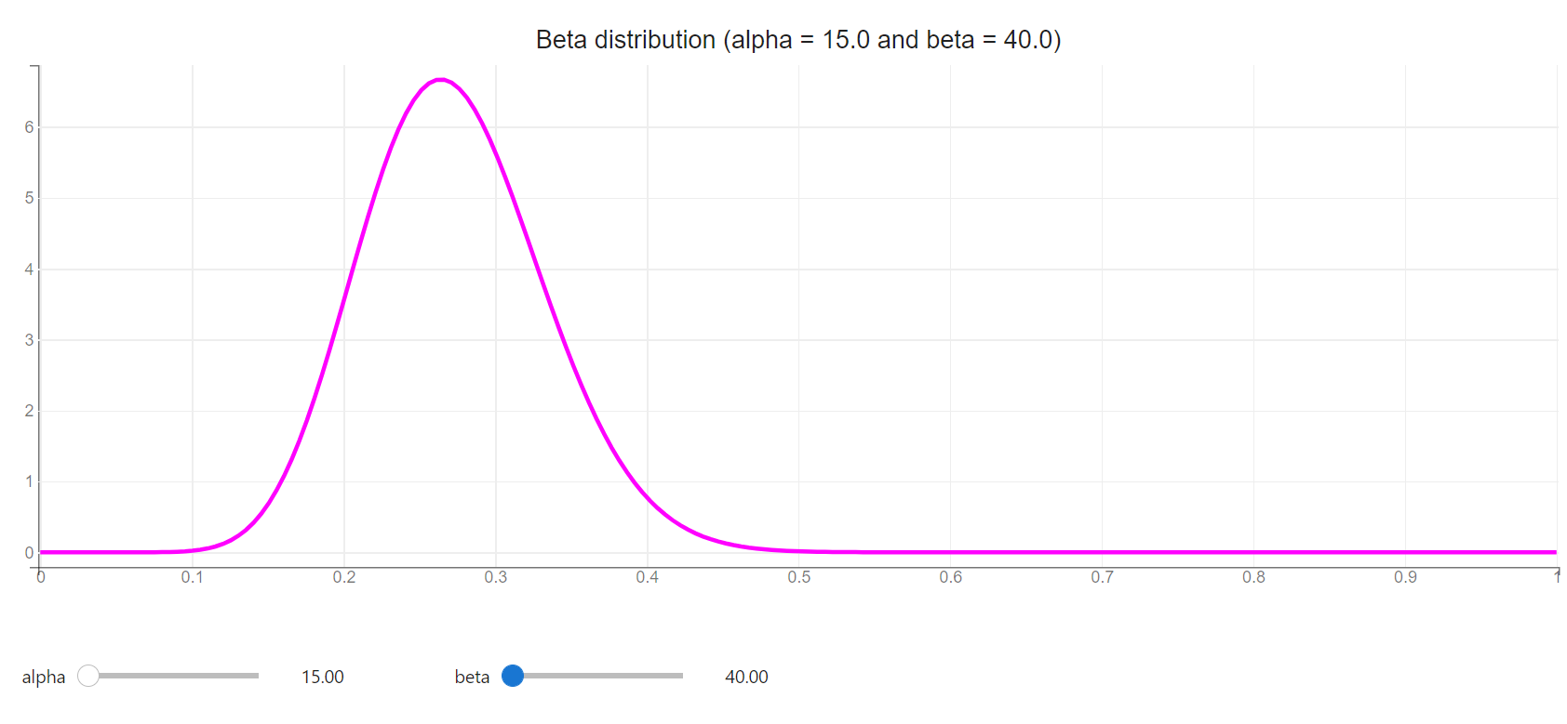
Prior to posterior transformation
As we see more and more successes the distribution shifts to the right (alpha is large)
As we see more and more failures the distribution shifts to the left (beta is large)
Adaptivity
Analytics

Slide 13
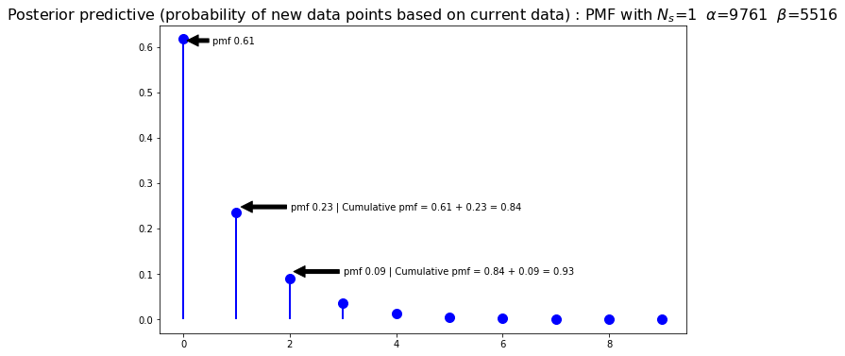
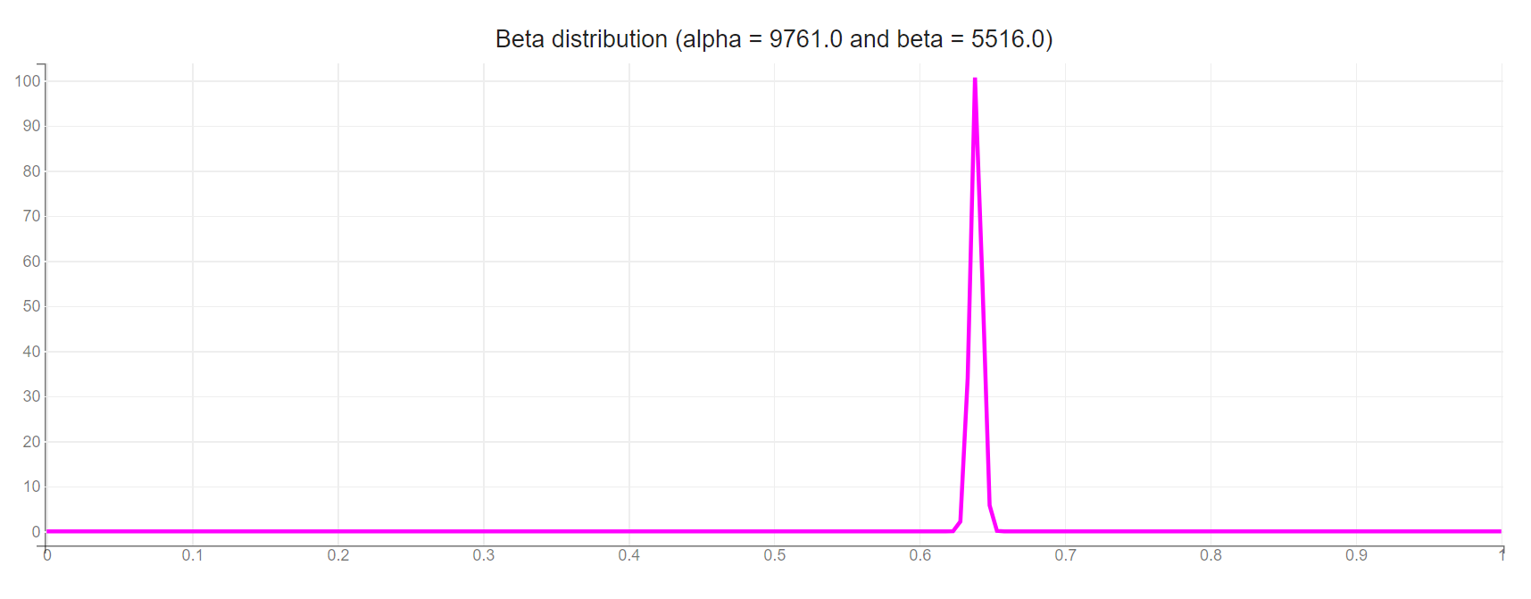
Prior to posterior transformation
This prior to posterior transformation guarantees transparency in user/model behaviors as new data comes in
Also shows how we can quickly scale from no to little data to lots of data smoothly
As we get more data, the probability distribution narrows and peaks
Adaptivity
Analytics

Slide 14
Smart defaults
"For a new LO (little/no data) in a domain, we use a "smart default" for the prior mean hyper-parameter, computed as the precision-weighted average of existing LO's log-duration means. This choice is motivated by a hierarchical Bayesian model"
Adaptivity
Analytics

Slide 15

Thanks to our team in Jersey City!!!
Michael Binger, Principal Data scientist
Andrew Jones, Lead Data scientist
Illya Bomash, Senior Director, Data Science
Adaptivity
Analytics

